Slide 1
Health Awareness and Nutrition
Overweight and Obesity
Department of Clinical Nutrition and Dietetics
College of Health Sciences

Slide 2
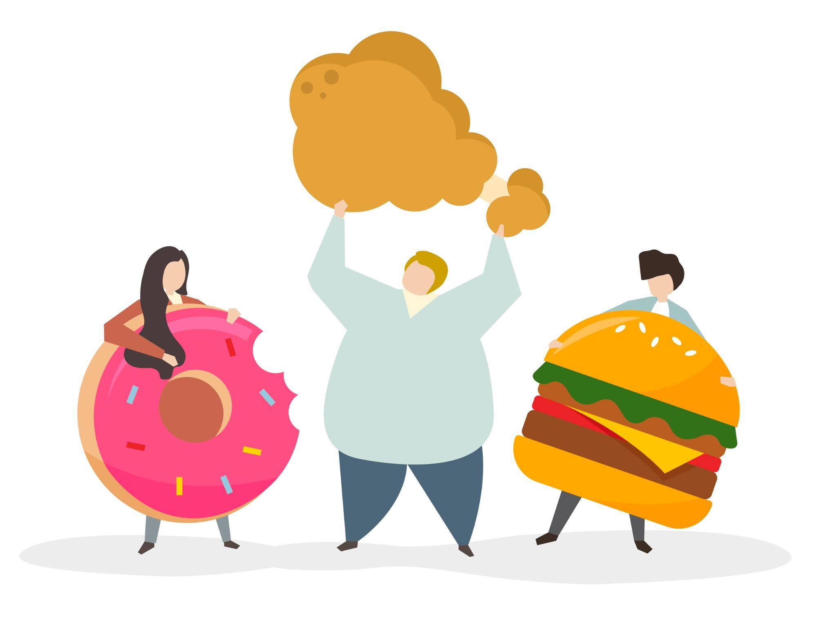
Obesity
Obesity is a chronic disease.
It is the result of Positive Energy Balance:
Energy intake exceeds energy expenditure
Low physical activity results in an excessive amount of body fat (adipose tissue)
Obesity is a medical condition in which excess body fat has accumulated and has an adverse effect on health, leading to increased health problems.

Slide 3
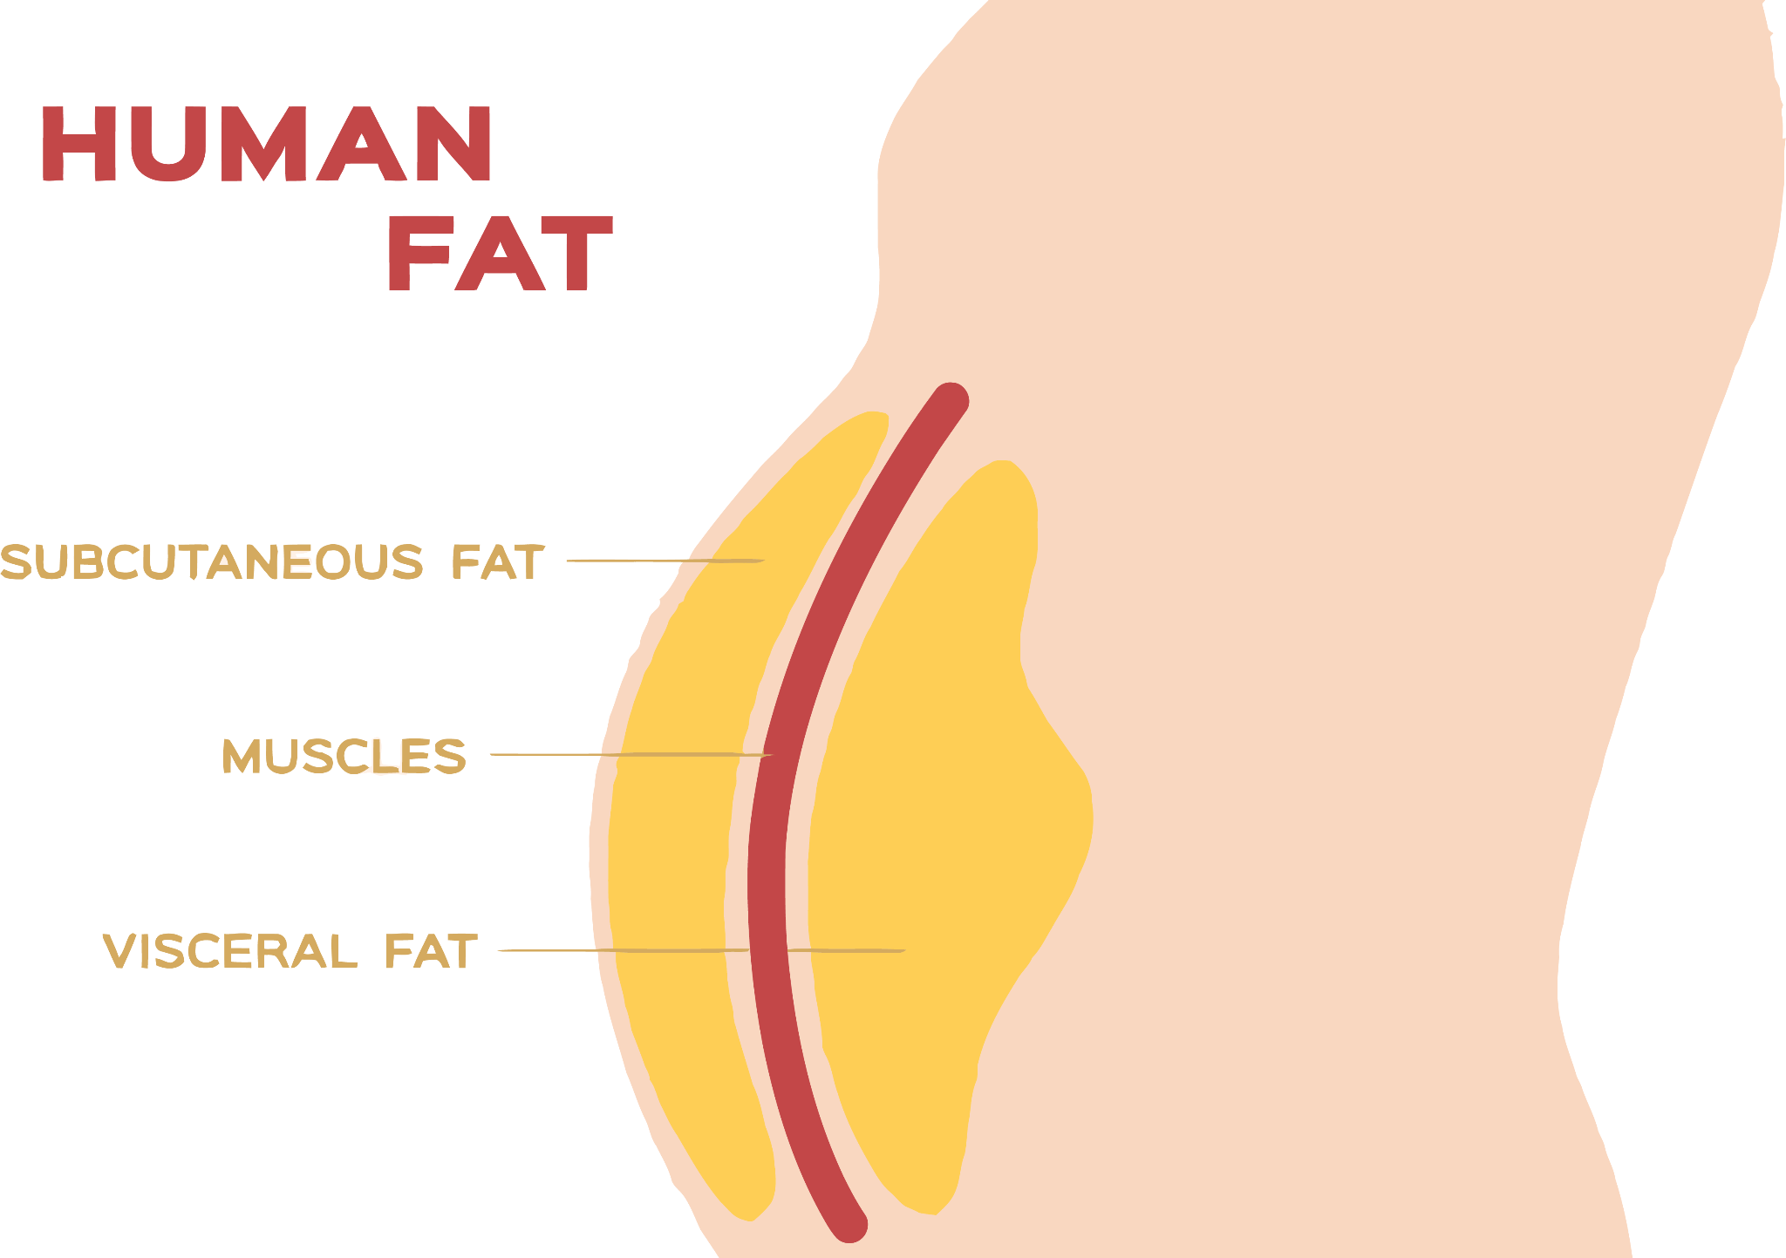
Central Obesity
Fat that accumulates around the central abdomen is called visceral fat and is very dangerous.
Central obesity increases the risk for lipid disorders, heart disease, diabetes, hypertension and others.

Slide 4
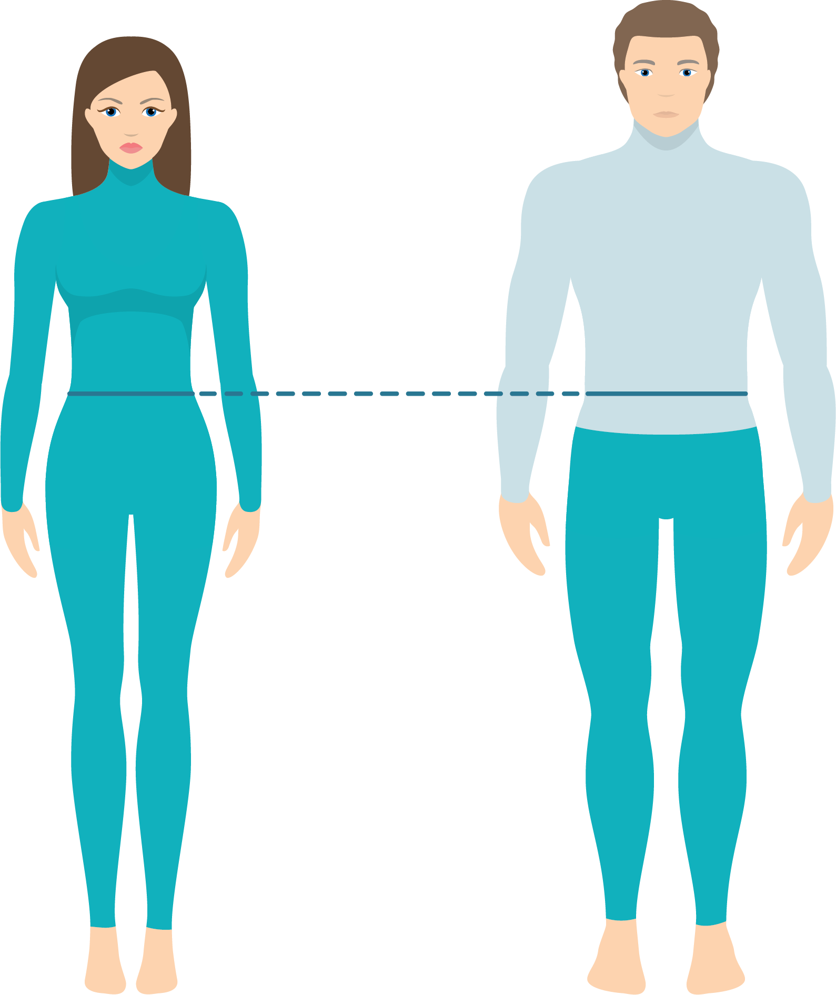
Central Obesity
Waist Circumference should be:
< 102 cm for males
< 88 cm for females
< 102 CM
< 88 CM

Slide 5
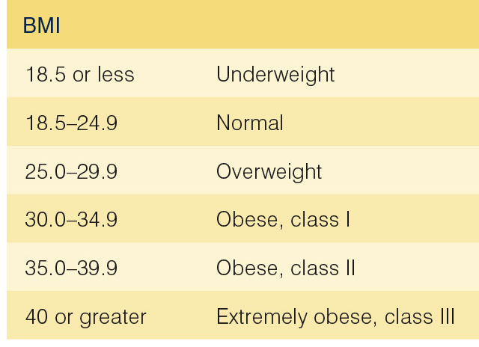
BMI
Body Mass Index (BMI) defines average relative weight for height in people older than 20 years.
BMI = weight in kg/(height in m)2
In general, the higher the BMI, the more risk of diseases.

Slide 6
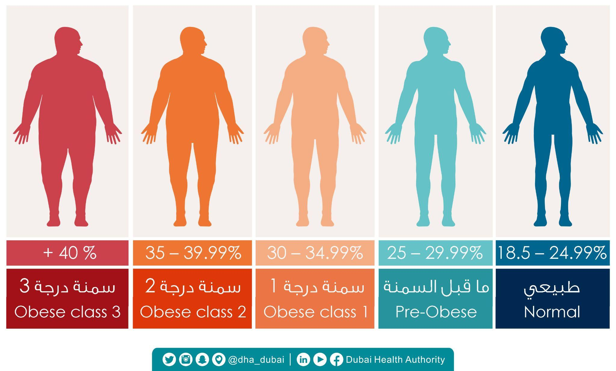
What is Your BMI?

Slide 7
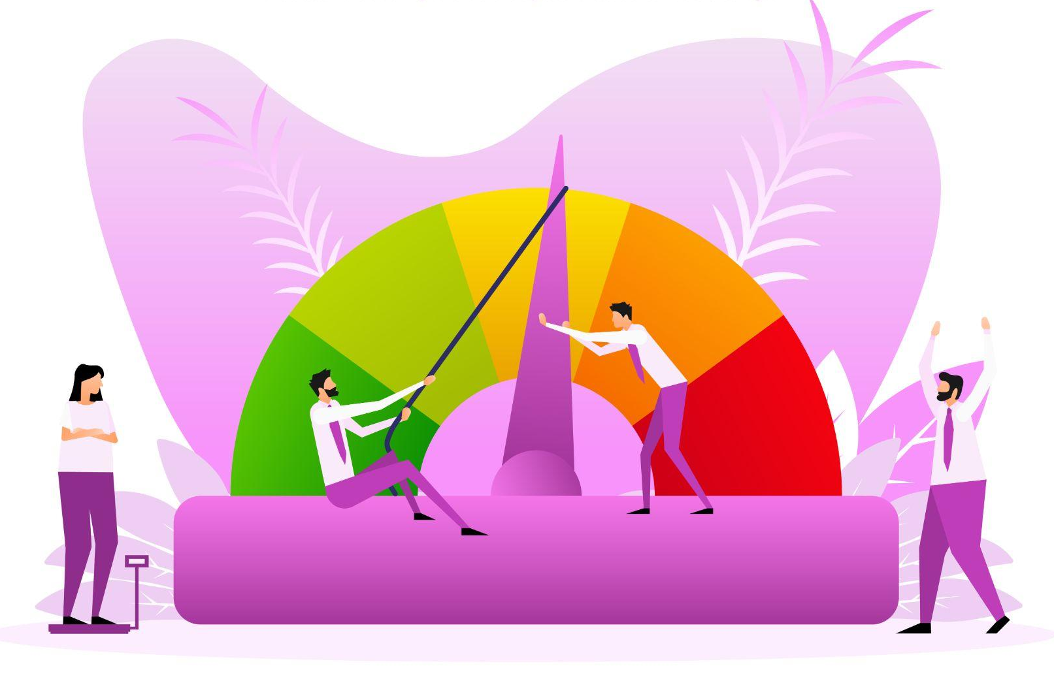
BMI
BMI Drawbacks:
BMI values fail to reveal body composition (% of body fat).
BMI values fail to reveal fat distribution (location of fat).
BMI evaluation is not suitable for:
Athletes (highly developed muscles falsely increase BMI)
Pregnant and lactating women
Children < 20 years old

Slide 8
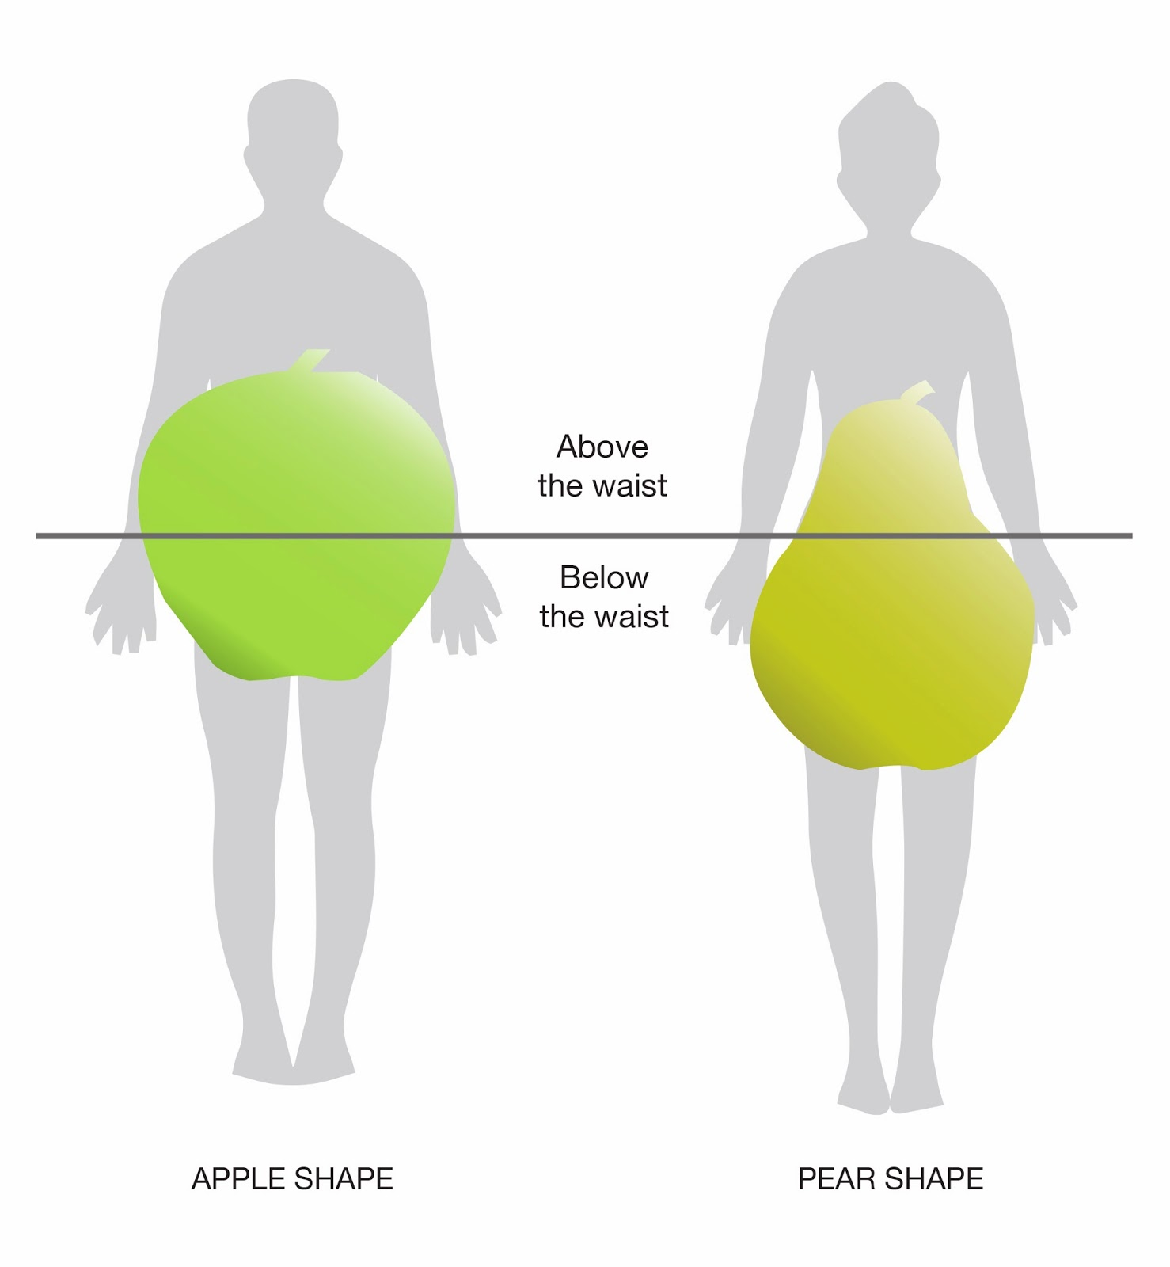
Types of Obesity
Women: 20-30% body fat
Gynoid obesity
Pear Shaped (fat mainly on the hip area)
Encouraged by female hormones
Stores of extra energy for pregnancy and lactation
More difficult to lose than abdominal fat
Men: 12-20% body fat
Android obesity
Apple Shaped (fat mainly on the waist area)
Encouraged by male hormones
Closer association with diseases
(cardiovascular, hypertension, diabetes)

Slide 9
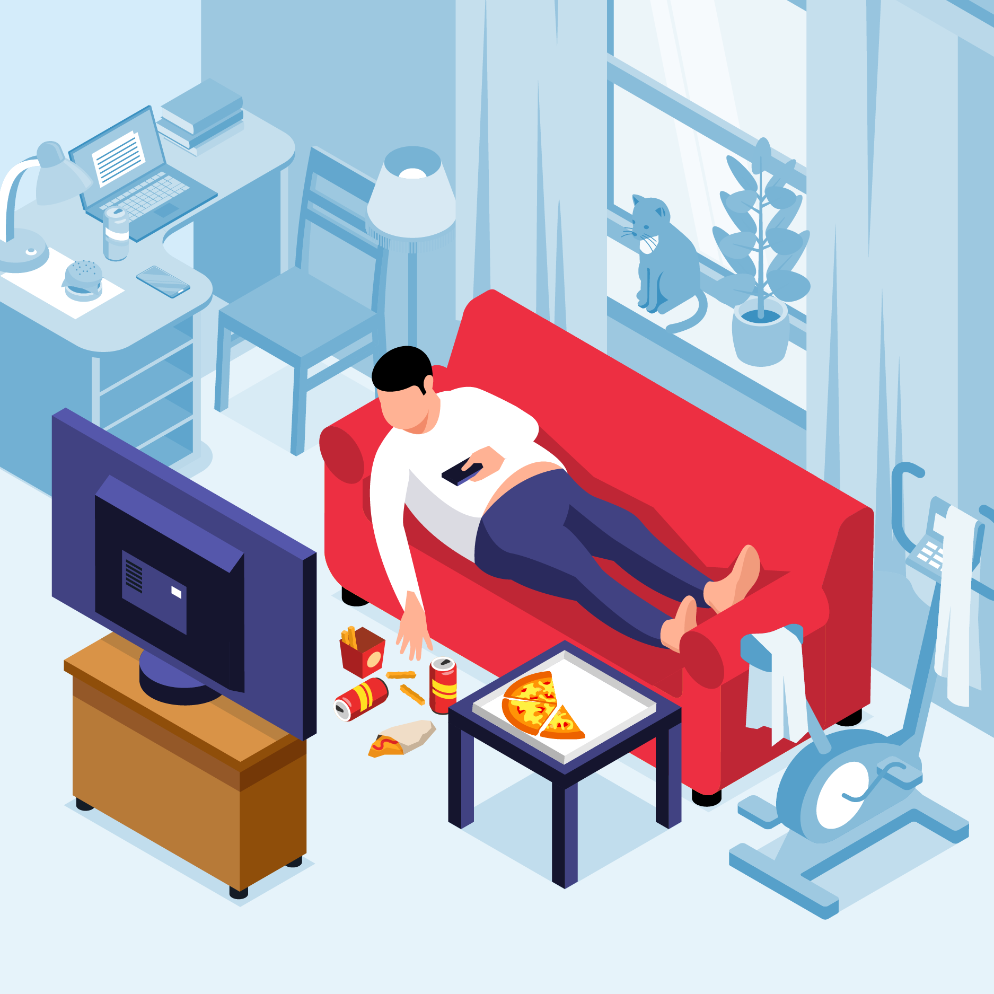
Causes of Obesity
Genetic factors: children from obese parents have a higher risk of being obese
Psychological factors: tension, anxiety, fear, humiliation (food acts as emotional support)
Behavioral factors: sedentary lifestyle
Eating habits: snacking in-between meals, eating late at night, intake of refined, starchy & fatty foods
Social aspects: social commitments, eating out, fast food restaurants
Physiological factors: the presence of disorders in the secretion of some hormones, especially thyroid hormones

Slide 10
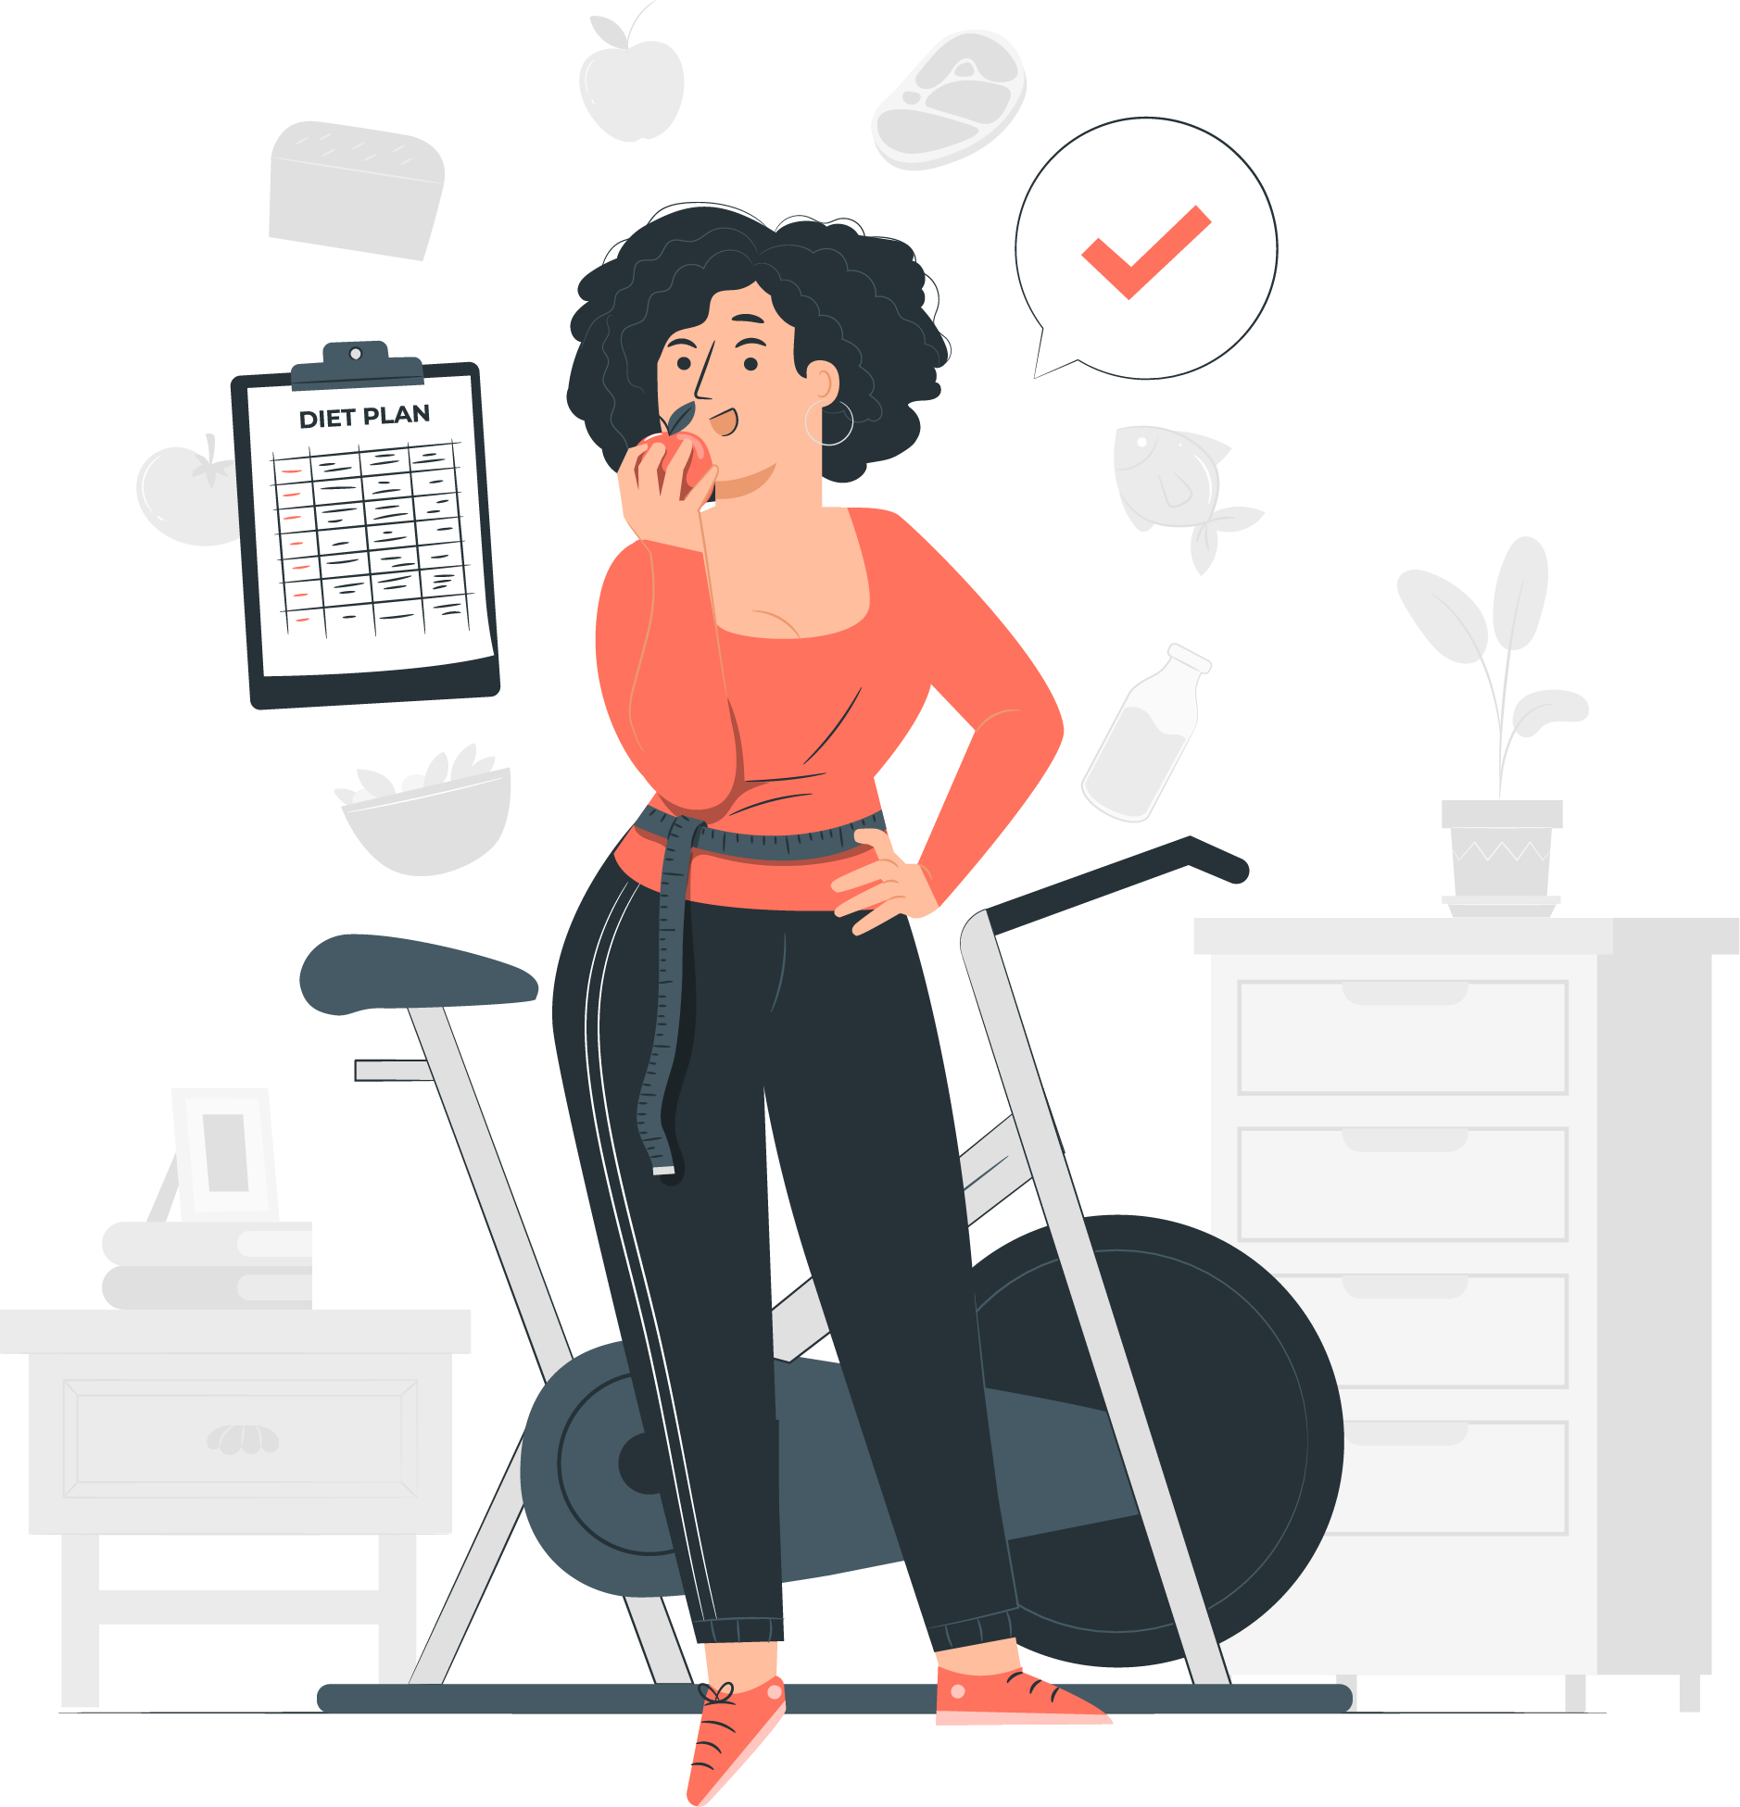
Treatment of Obesity
Best ways to fight obesity:
Diet therapy
Physical activity
Behavior modification
Sometimes drugs and surgery are needed (with all of the above)
Dietary approach:
Gradually lose weight
Achieve and maintain desirable body weight and a good nutritional status
Correct faulty eating habits

Slide 11
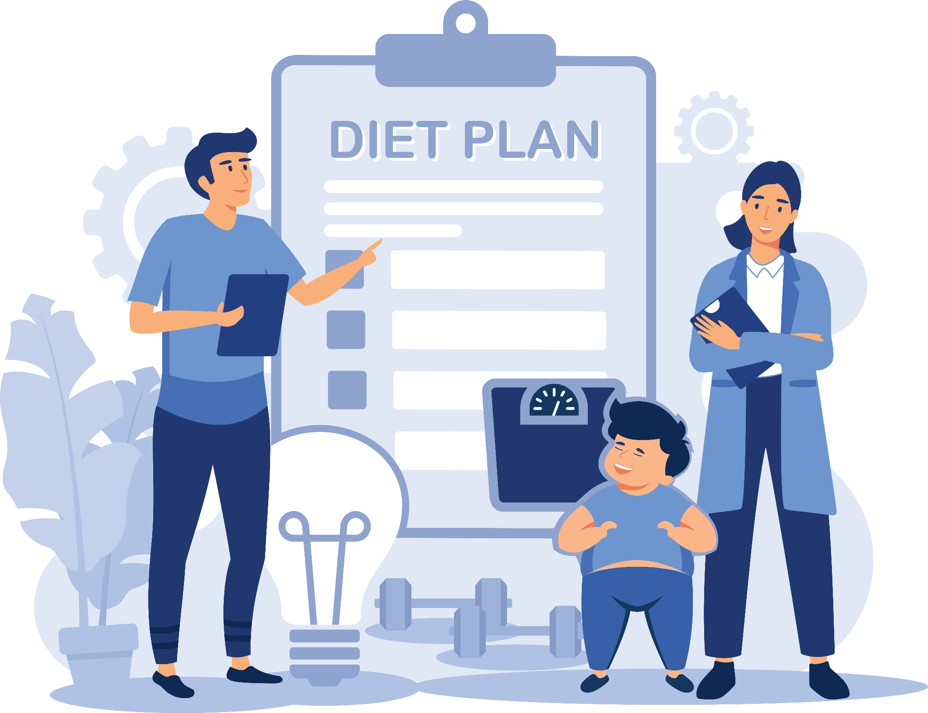
Treatment of Obesity
Weight reducing diets should be:
Low in energy
Adequate in other nutrients (vitamins and minerals)
Provide satiety
Easily adapted from family meals
Easy to follow even when eating out
Reasonable in cost
Able to modify dietary behavior

Slide 12
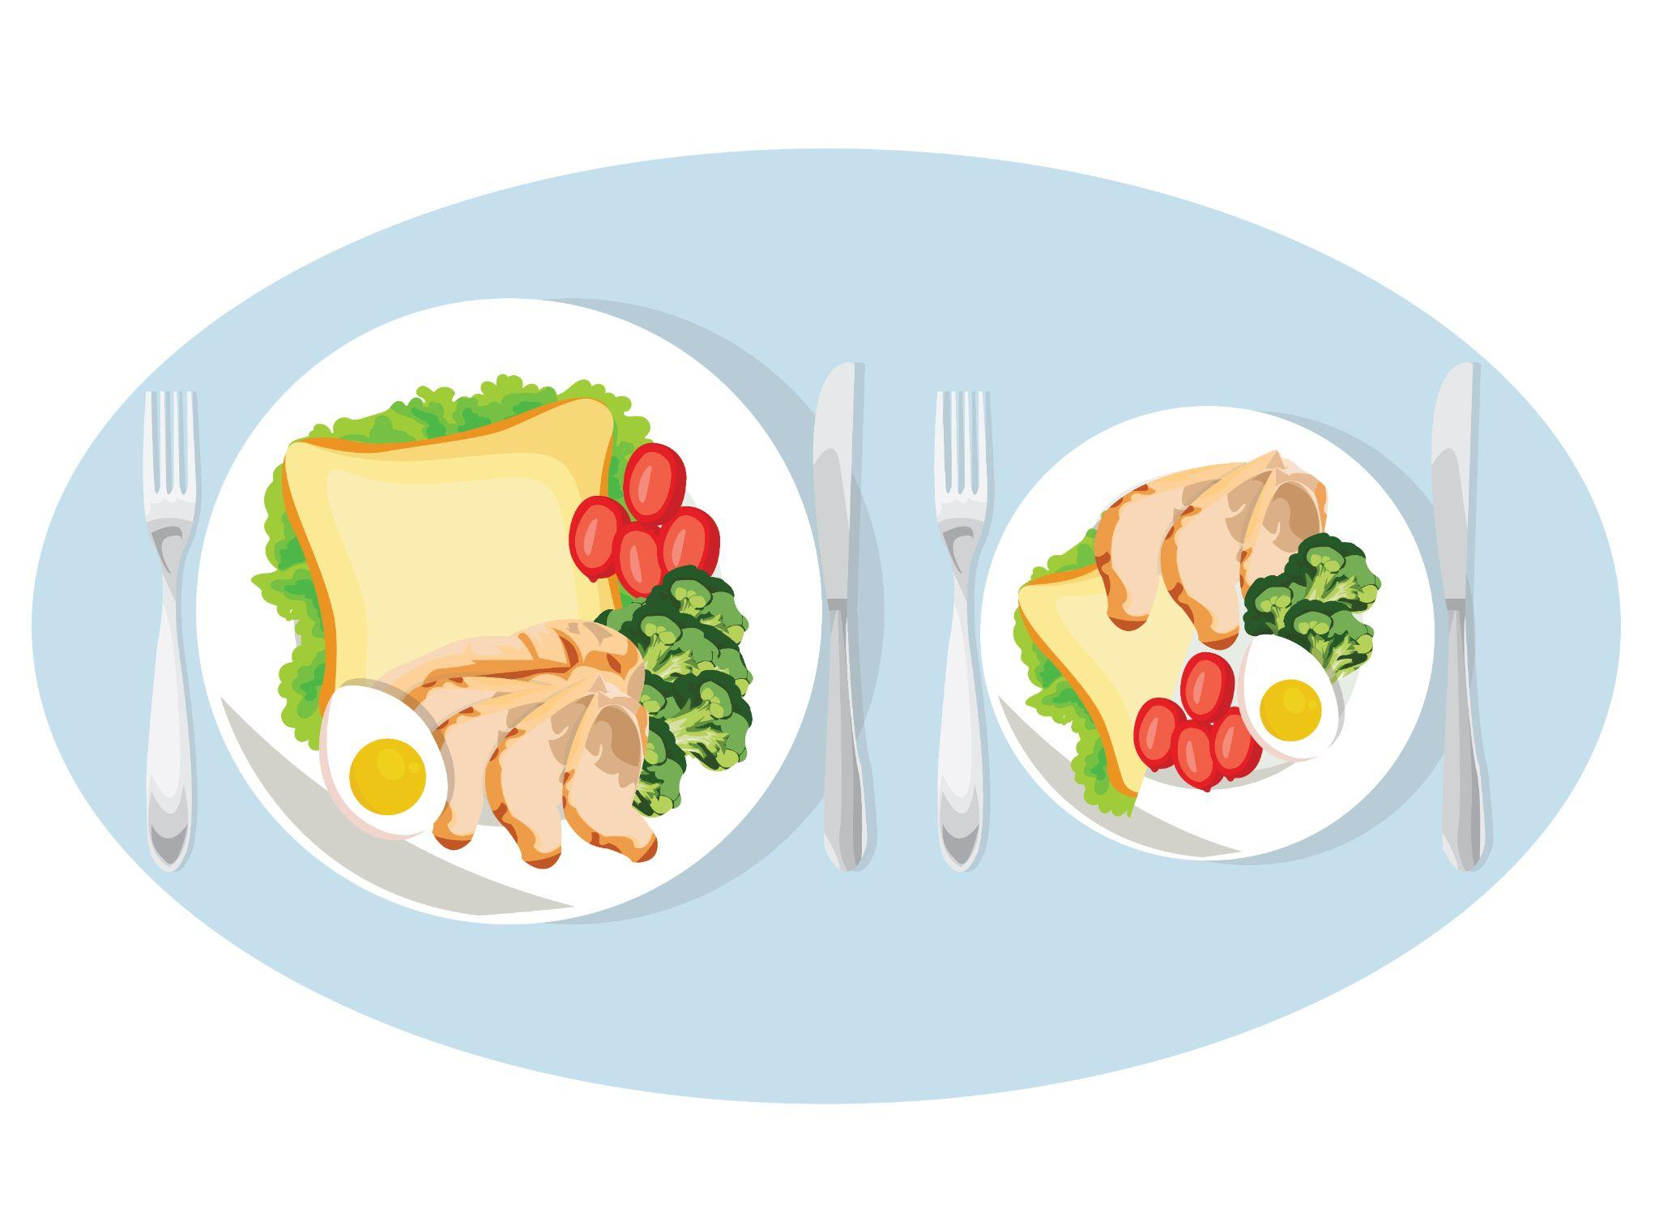
Treatment of Obesity
Other recommendations:
Eat smaller portions
Lower energy density of food
Remember to drink more water
Focus on complex carbohydrates (fibers)
Choose fats sensibly
Focus on physical activity

Slide 13
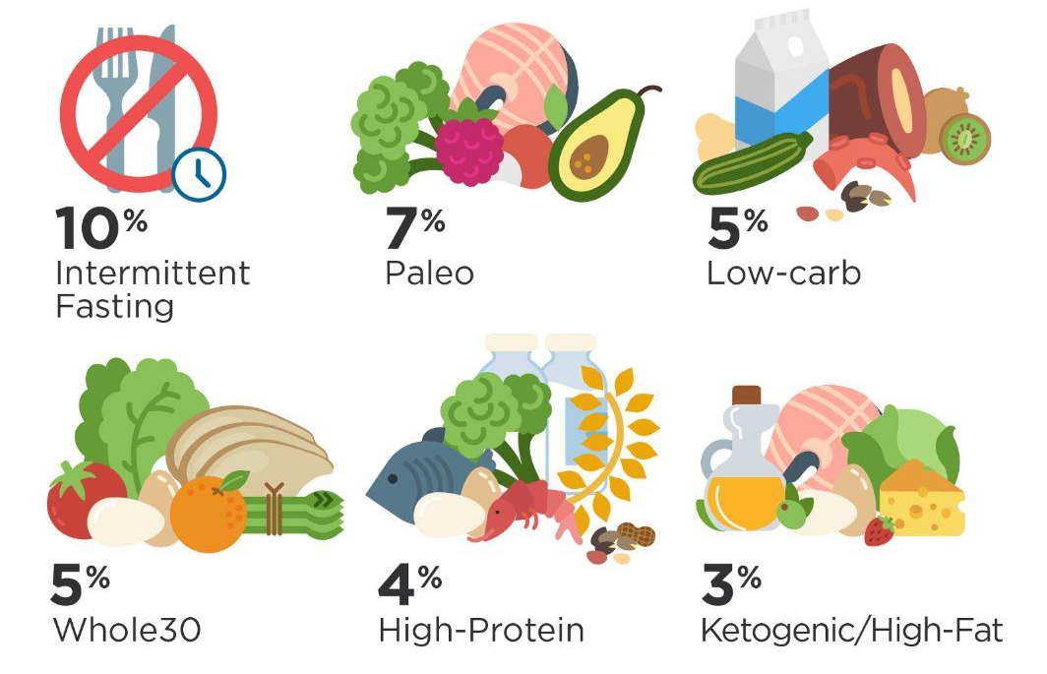
Extreme Approaches to
Weight Loss
Fad diets:
“Quick action” diets based on misinformation, which result in nutritional imbalance.

Slide 14
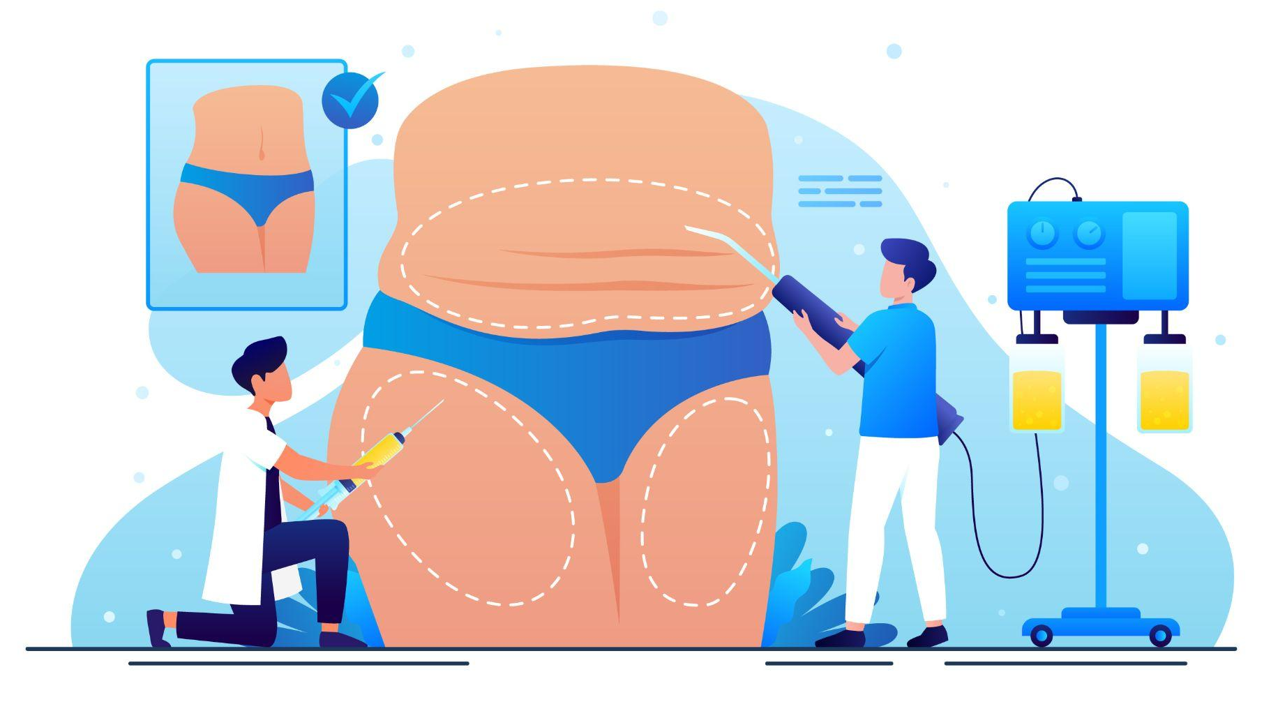
Extreme Approaches to
Weight Loss
Fasting/Starvation/Dieting: leads to the formation of toxic (poisonous) substances in body & may even cause death due to loss of heart muscle
Body wraps & special clothing: results in temporary weight loss
Drugs: appetite suppressants (drugs to help fat absorption etc.) have negative side effects
Surgery: like liposuction, gastric banding, gastric bypass, and ballooning also have side effects

Slide 15

Healthy Tips
Set achievable goals for weight loss (0.5-1Kg per week).
Adapt scientific needs to family meals by choosing healthy methods of cooking (baking, boiling, steaming, roasting) and fats, starch, sugar and salt intake in the diet.
Do not be disturbed about weight plateaus (energy intake = energy output). Get started again with exercise.
Avoid binges (eating too much at one time).
Eat small meals at frequent intervals and spread energy throughout the day.
Be careful while eating out – choose healthy options in smaller amounts.

